Slide 1
Intro to Spark & Scala
guole5@jd.com
2016-06-14

Slide 2
Outline
Spark Motivation
Programming model
Example applications
Scala
Demo

Slide 3
Motivation
Most current cluster programming models are based on acyclic data flow from stable storage to stable storage
Map
Reduce
Input
Map
Output
Reduce
Map
Notes:
Benefits: easy to do fault tolerance

Slide 4
Motivation
Acyclic data flow is inefficient for applications that repeatedly reuse a working set of data:
Iterative algorithms (machine learning, graphs)
Interactive data mining tools (R, Excel, Python)
With MapReduce framework, apps reload data from stable storage on each query

Slide 5
Solution: Resilient Distributed Datasets
Allow apps to keep working sets in memory for efficient reuse
Retain the attractive properties of MapReduce
Fault tolerance, data locality, scalability
Support a wide range of applications
Instead of specialized APIs for one type of app, give user first-class control of distributed datasets
Notes:
RDDs = first-class way to manipulate and persist intermediate datasets

Slide 6
Outline
Spark Motivation
Programming model
Example applications
Scala
Demo

Slide 7
Programming Model
Resilient distributed datasets (RDDs)
Immutable, partitioned collections of objects
Created through parallel transformations (map, filter, groupBy, join, …) on data in stable storage
Can be cached for efficient reuse
Actions on RDDs
Reduce, collect, count, save, …
Restricted shared variables
Accumulators, broadcast variables
Notes:
You write a single program → similar to DryadLINQ
Distributed data sets with parallel operations on them are pretty standard; the new thing is that they can be reused across ops
Variables in the driver program can be used in parallel ops; accumulators useful for sending information back, cached vars are an optimization
Mention cached vars useful for some workloads that won’t be shown here
Mention it’s all designed to be easy to distribute in a fault-tolerant fashion

Slide 8

Example: Log Mining
Load error messages from a log into memory, then interactively search for various patterns
Cache 1
Worker
Transformed RDD
results
Base RDD
val lines = sc.textFile(“hdfs://...”)
val errors = lines.filter(_.startsWith(“ERROR”))
val messages = errors.map(_.split(‘\t’)(2))
messages.cache()
tasks
Driver
Block 1
Action
Cache 2
messages.filter(_.contains(“foo”)).count
Worker
messages.filter(_.contains(“bar”)).count
Cache 3
Result: full-text search of Wikipedia in <1 sec (vs 20 sec for on-disk data)
Worker
Block 2
Result: scaled to 1 TB data in 5-7 sec (vs 170 sec for on-disk data)
. . .
Block 3
Notes:
Key idea: add “variables” to the “functions” in functional programming

Slide 9
Cluster components

Slide 10
RDD Fault Tolerance
RDDs maintain lineage information that can be used to reconstruct lost partitions
Ex:
val messages = sc.textFile(...)
.filter(_.startsWith(“ERROR”))
.map(_.split(‘\t’)(2))
HDFS File
Filtered RDD
Mapped RDD
filter (func = _.contains(...))
map (func = _.split(...))

Slide 11
Spark Operations
Transformations (define a new RDD) | map filter sample groupByKey reduceByKey sortByKey | flatMap union join cogroup intersectioin distinct
Actions (return a result to driver program) | collect reduce count countByKey take takeSample saveAsTextFile foreach

Slide 12
Benefits of RDD Model
Consistency is easy due to immutability
Inexpensive fault tolerance (log lineage rather than replicating/checkpointing data)
Locality-aware scheduling of tasks on partitions
Despite being restricted, model seems applicable to a broad variety of applications
Notes:
General data flow models: MapReduce, Dryad, SQL
Specialized models for stateful apps: Pregel (BSP), HaLoop (iterative MR), Continuous Bulk Processing

Slide 13
Outline
Spark Motivation
Programming model
Example applications
Scala
Demo

Slide 14
Example: Logistic Regression
val data = sc.textFile(...).map(readPoint).cache()
var w = Vector.random(D)
for (i <- 1 to ITERATIONS) {
val gradient = data.map(p =>
(1 / (1 + exp(-p.y*(w dot p.x))) - 1) * p.y * p.x
).reduce(_ + _)
w -= gradient
}
println("Final w: " + w)

Slide 15
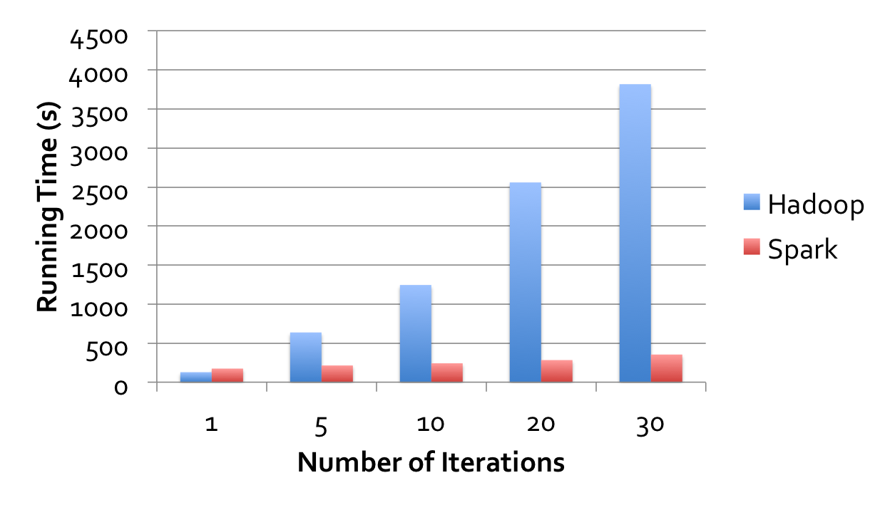
Logistic Regression Performance
127 s / iteration
first iteration 174 s
further iterations 6 s
29 GB dataset on 20 EC2 m1.xlarge machines (4 cores each)

Slide 16
Example: MapReduce
MapReduce data flow can be expressed using RDD transformations
res = data.flatMap(rec => myMapFunc(rec))
.groupByKey()
.map((key, vals) => myReduceFunc(key, vals))
Or with combiners:
res = data.flatMap(rec => myMapFunc(rec))
.reduceByKey(myCombiner)
.map((key, val) => myReduceFunc(key, val))

Slide 17
Word Count in Spark
val lines = spark.textFile(“hdfs://...”)
val counts = lines.flatMap(_.split(“\\s”))
.map(x => (x,1))
.reduceByKey(_ + _)
counts.saveAsTextFile(“hdfs://...”)

Slide 18
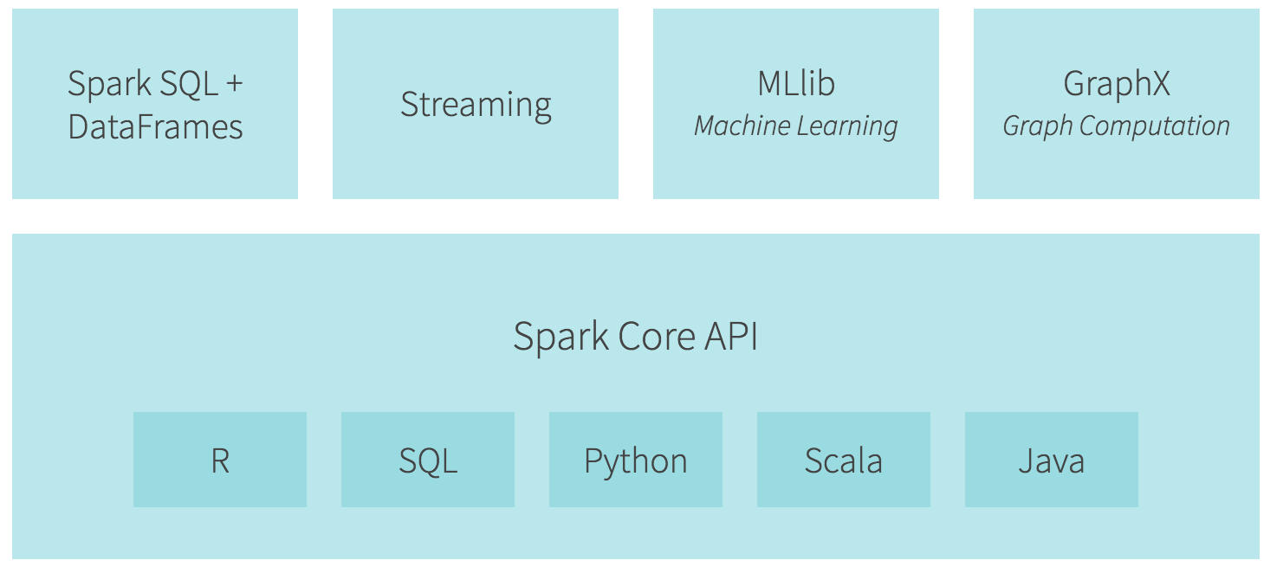
Ecosystem

Slide 19
Spark Streaming

Slide 20
Applications We built on Spark
JD App CPA(Charge per Action) anti fraud. (2015.10 ~ )
Price service crawler detection. (2015.12 ~)
Aggregational Feature extraction engine. (2016.3 ~)
Ads position anomaly detection. (2016.4 ~)
Daily case analysis.

Slide 21
Benefits (compared with hadoop / hive)
Fast
Concise, readable code
Interactive
Standalone mode
Easy to do unit test

Slide 22
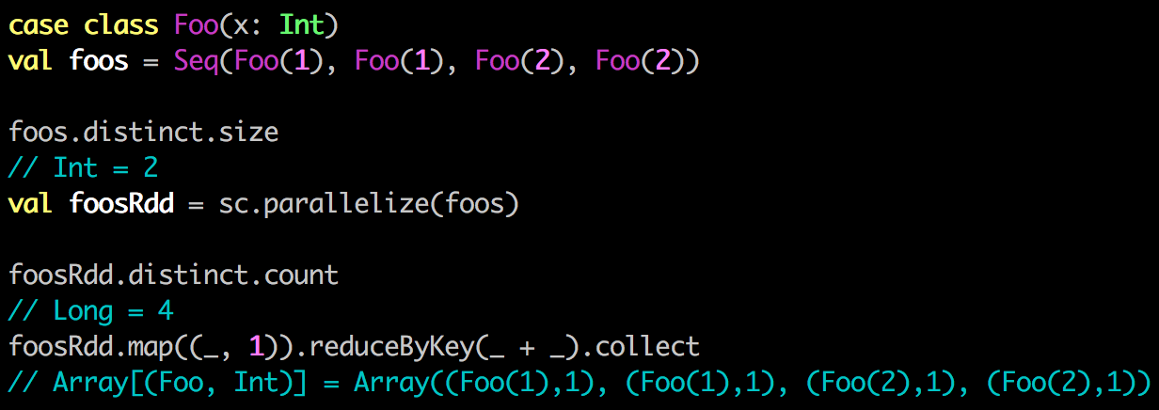
Pitfalls
Task not serializable Exception.
Driver OOM while using reduceByKey
Limit partition number.
spark-shell behave different from spark-submit
Nested class equalty: Spark-shell create wrapper objects for each command
https://issues.apache.org/jira/browse/SPARK-2620
Notes:
That hash map is just a list of where each task ran, it’s not the actual data.

Slide 23
Outline
Spark Motivation
Programming model
Example applications
Scala
Demo

Slide 24
Scala – “Scalable Language”
Object-Oriented
Functional
Seamless Java Interop
Functions are Objects
Parallel and Concurrent
Notes:
signifying that it is designed to grow with the demands of its users.

Slide 25
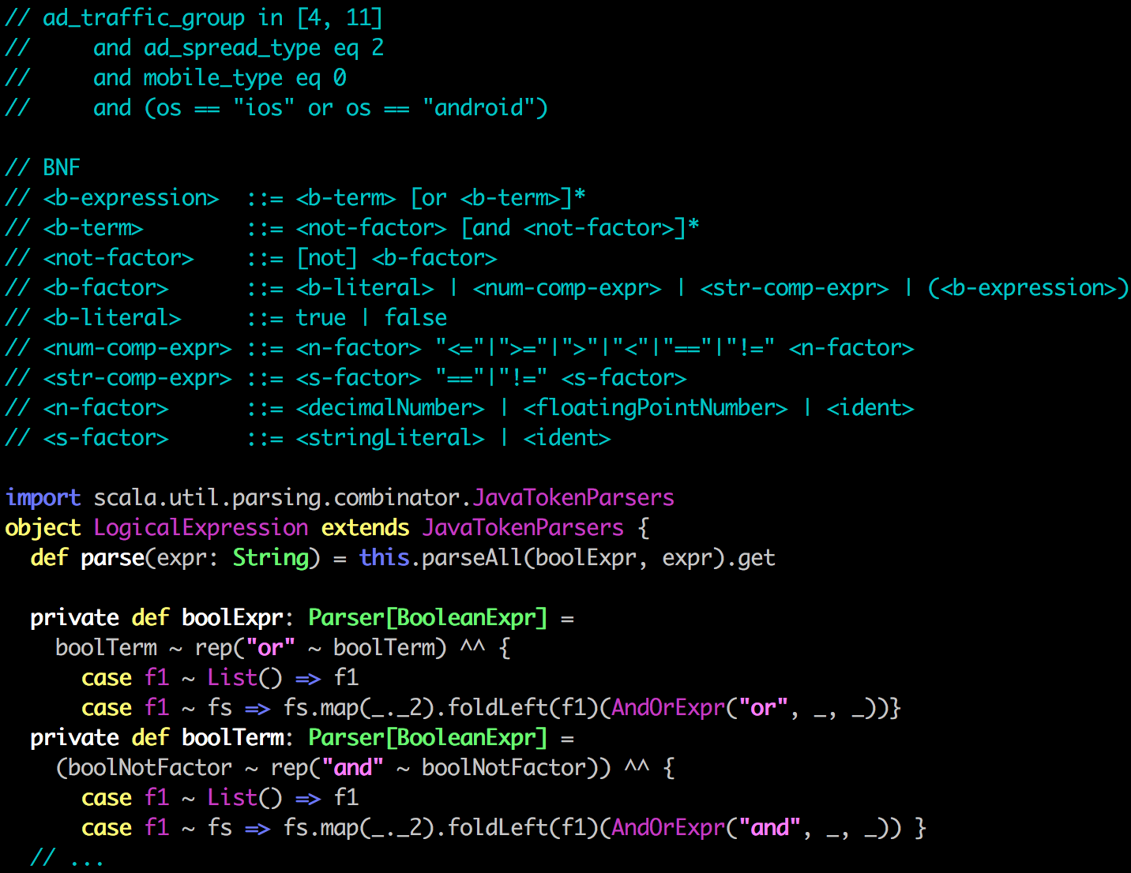
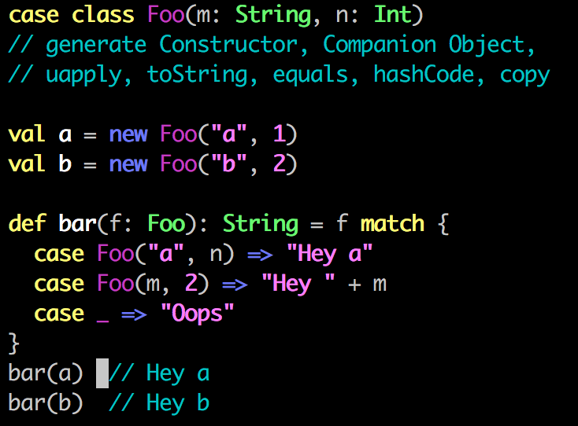
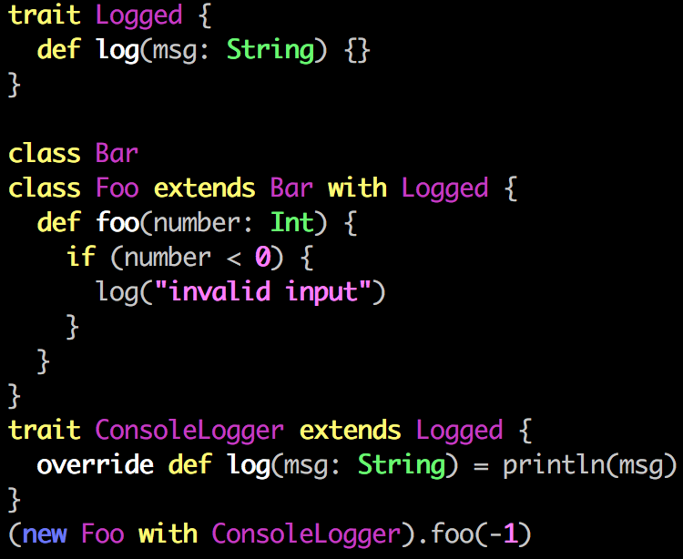
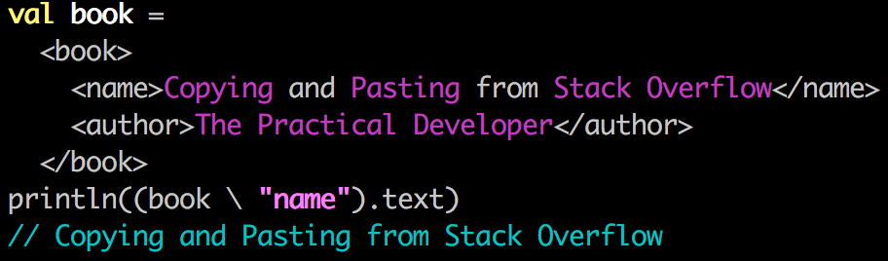
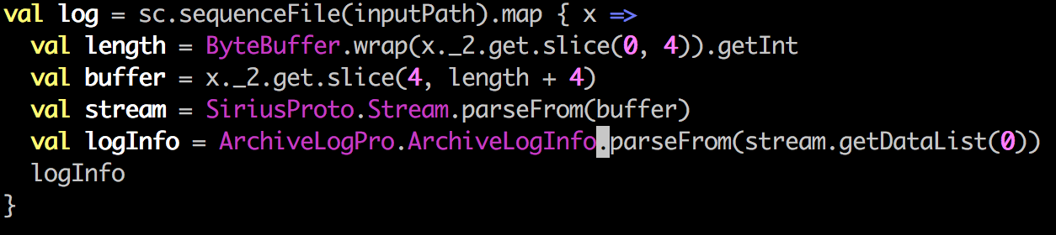
Snippets
Case class, Pattern matching, Extractor
Trait
DSL, Embedded XML
Using Java
Parser Combinator

Slide 26
Outline
Spark Motivation
Programming model
Example applications
Scala
Demo

Slide 27
REPL
spark-shell
scala> sc
res0: org.apache.spark.SparkContext = SparkContext@3cf94dad
scala> val textFile = sc.textFile("guole/spark/input/*")
scala> textFile.count
res0: Long = 3611069
scala>val wordCount = textFile.flatMap(x => x.split("\t")).map(x => (x,1)).reduceByKey(_+_)
scala> wordCount.take(10).foreach(println)
scala> sqlContext.sql("select …").collect

Slide 28
Deploy and Run
build.sbt
name := "Simple Project"version := "1.0”
version := "2.10.4”
libraryDependencies += "org.apache.spark" %% "spark-core" % "1.4.0”
sbt package
spark-submit –master local[2] --class "SimpleApp" target/scala-2.10/simple-project_2.10-1.0.jar

Slide 29
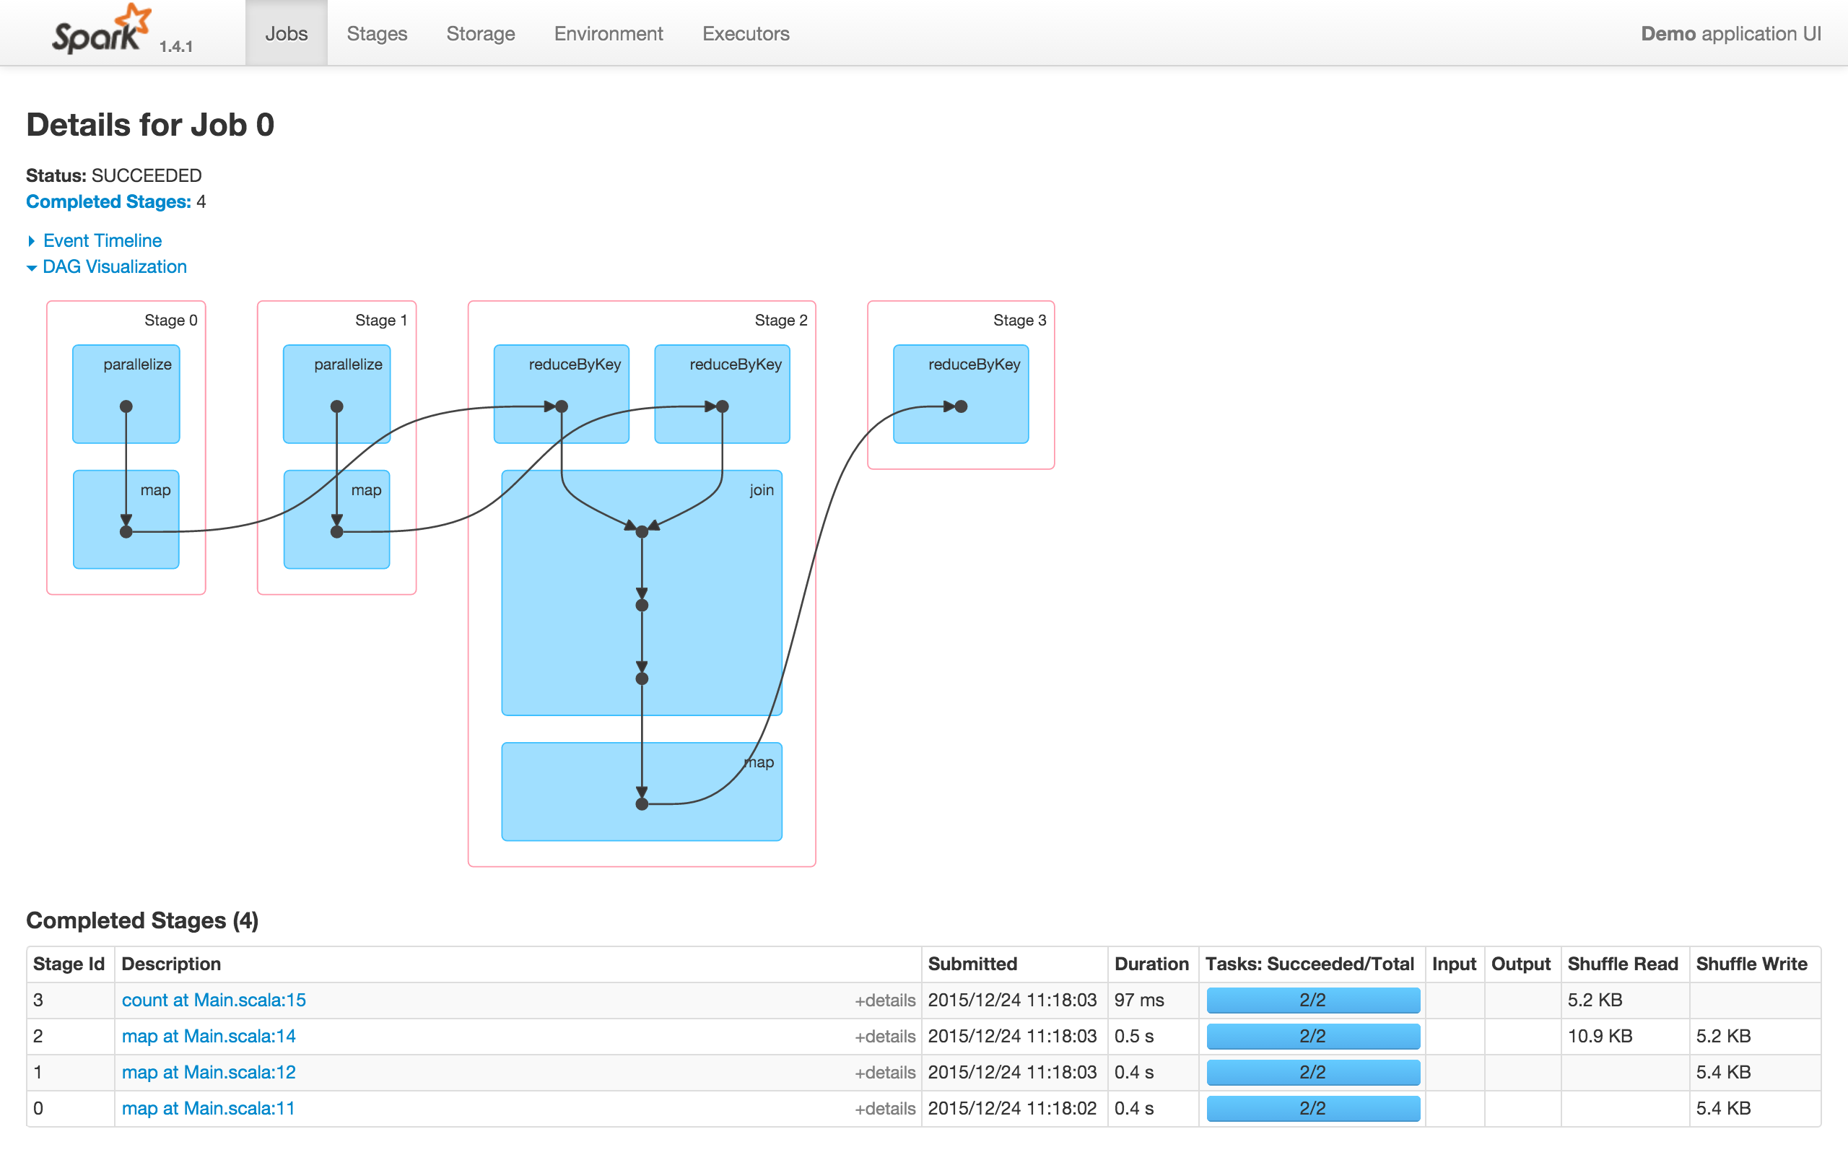
Spark UI
http://172.22.168.103/proxy/${applicationid}

Slide 30
Conclusion
Speed
Iterative algorithms
Interactive data mining
Enhance programmability:
Integrate into Scala programming language
Allow interactive use from Scala interpreter
Unified Stack
Batch, Streaming, SQL, machine learning
Notes:
Point out that interactive use and iterative use go hand in hand because both require small tasks and dataset reuse

Slide 31
reference
https://people.csail.mit.edu/matei/papers/2010/hotcloud_spark.pdf
https://spark.apache.org/docs/latest/index.html
https://spark.apache.org/talks/overview.pptx

Slide 32
Q&A
Thanks

